Slide 1




Digital Journalism Summit 2017
In association with
@PressGazette @NewsUK @Newsdit2 #Journosummit17

Slide 2
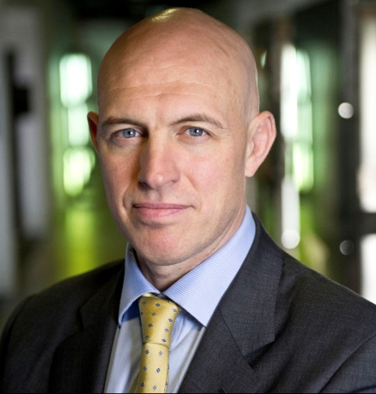
WELCOME FROM DAVID DINSOMORE
NEWS UK - CHIEF OPERATING OFFICER
@PressGazette @NewsUK @Newsdit2 #Journosummit17

Slide 3
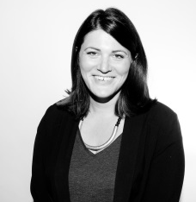
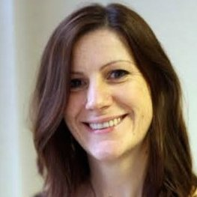
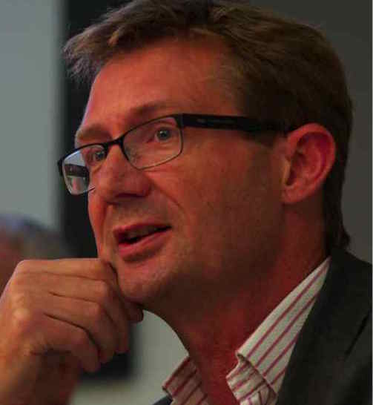
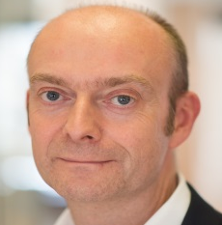
OVERVIEW OF THE DIGITAL NEWS ECOSYSTEM
Polly Curtis – Editor-in-Chief, HuffPost
Alison Gow – Editor-in-Chief, Digital, Trinity Mirror
Douglas McCabe – CEO and Director of publishing and Tech, Enders Analysis
Nic Newman – Senior Research Associate, Oxford University
@PressGazette @NewsUK @Newsdit2 #Journosummit17

Slide 4


AUDIENCE TRENDS AROUND DIGITAL NEWS
Nic Newman, Reuters Institute, University of Oxford
20 October 2017
@risj_oxford | #DNR17 |

Slide 5

An increasingly distributed environment
GATEWAYS TO NEWS CONTENT
% who use each path weekly
Majority side door access (more with U35s)
STORIES SELECTED BY ALGORITHMS APROACHING THOSE SELECTED BY EDITORS

Slide 6
BBC in the UK has high direct traffic. Sun, Mirror and Independent, not so much

Slide 7
Do we notice news brands in distributed environments?

Slide 8
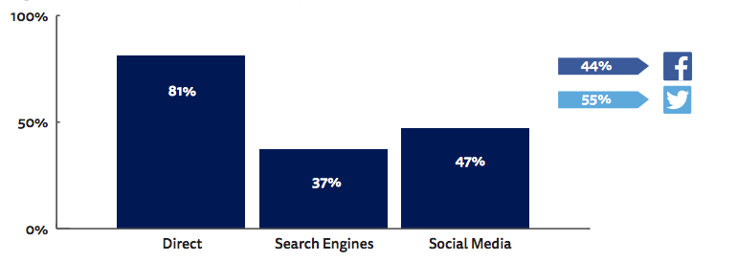
Headline finding
People remember the brand less than half the time when coming from search or social
2X difference
“IT’S THEIR JOB … TO REPORT THE FACTS”
Q2. You recently viewed a story with the headline X. On which of the following news websites did you read this story? If you read it on more than one, please select all that apply. Showing share of correct brand attributions. Base: Direct 1,098/ Search 1,022/ Social 1,008 (Facebook 795, Twitter 194)

Slide 9
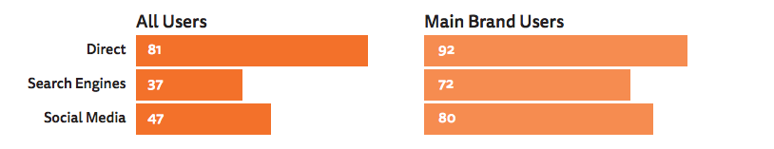
Loyalty makes a difference
If you already had a strong relationship (e.g. say BBC or Mail was your main brand) you are much more likely to remember the brand when coming from search or social
Loyalty effect
+11
+35
+33
“IT’S THEIR JOB … TO REPORT THE FACTS”
Q2.. On which of the following news websites did you read this story? Q6. Which would you say is your MAIN source
of news online? Base: Direct 1,098/ Search 1,022/ Social 1,008. Those who were exposed to a news story of their main source of news:
Direct 686/ Search 129/ Social 208.

Slide 10


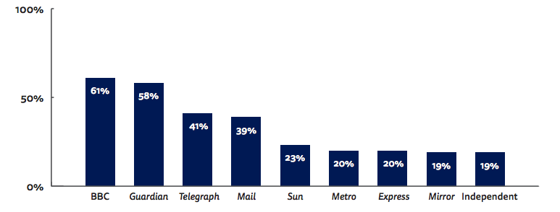
Correct attribution by brand - search
Some brands have much higher recognition than others
61%
3X difference
19%
“IT’S THEIR JOB … TO REPORT THE FACTS”
Q2. On which of the following news websites did you read this story?
Base: BBC 101, Guardian 181, Telegraph 139, Mail 138, Metro 52, Sun 90, Mirror 86, Express 61, Independent 65

Slide 11


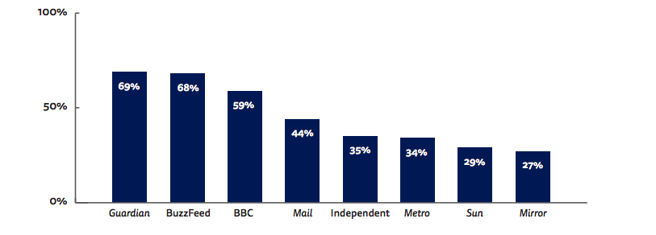
Correct attribution - social
Some brands have much higher recognition than others
68%
2.2X difference
29%
Q2. On which of the following news websites did you read this story?
Base: BBC 170, BuzzFeed 62, Guardian 153, Mail 58, Metro 60, Sun 64, Mirror 55, Independent 102

Slide 12
Paying for news

Slide 13
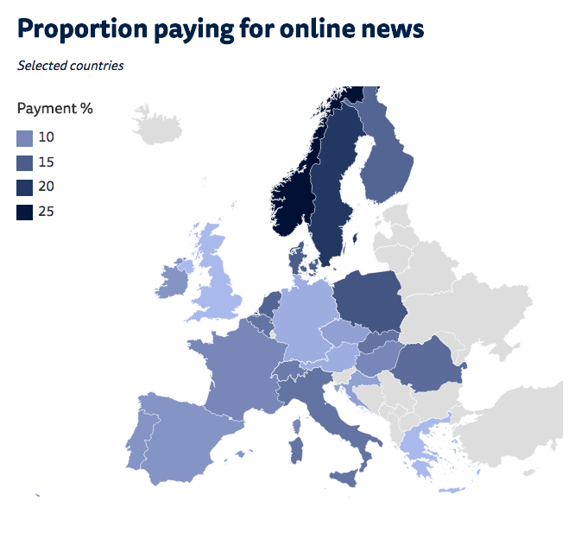


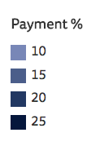
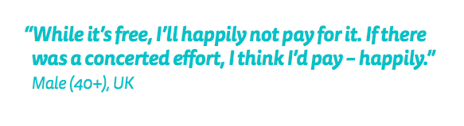
UK consumers are least likely to pay for online news
Proportion who pay for any online news
European countries
13%
PAY
Highest in Norway
26%
PAY FOR
ONLINE NEWS
Lowest in UK
6%
ALL COUNTRIES

Slide 14
Why pay for online news?
Combination of content, brand and platform benefits – but doesn’t motivate everyone
QUALITY
CONTENT
PLATFORM
BENEFITS
BRAND
BENEFITS
“You know that it’s real as you’re paying for it. You know that someone hasn’t made it up.” (20-34, UK)
“You enjoy the format in which they present their news and you want to pay for that.” (35-54, UK)
“Some people are more engaging, I find. Personally, that’s why I pay for the New York Times.” (20-34, US)
Notes:
The content alone is unlikely to be enough (because of abundance) but, combined with convenience and brand, there is hope
Quality content
Great journalism, expert analysis
Enjoy writing style – incisive, distinctive, witty
Breadth of coverage – something for everyone
Specialist news, topics of interest (e.g. sport, science, technology, arts, fashion)
Exclusives, behind the scenes access
Valuable extras (e.g. crossword, archive)
Helpful for work/study
Platform benefits
Customise app, prioritise content of interest
Convenience of app when commuting
Easy access across devices
Unrestricted ad-free access (soft paywall)
(Got a special deal)
Brand benefits
Familiarity/habit, enjoy brand – extension/ replacement of print subscription
US (one person): to support the brand, ensure investigative journalism and robust media
And to avoid pitfalls (esp. US)
More trustworthy than other online content
US: avoid fake news and click-bait
Quality assurance of reputable brand

Slide 15

Lessons in technology, the appeal of aggregation
“
The thing is that they’re blaming aggregators, but I’m saying that aggregators are a great thing. But it doesn’t mean they all have to be aggregated from different news sources. It could be aggregated from different journalists from the same umbrella. As long as I can pick up and choose the stories or the journalists that I want to hear, I don’t care if they do all work for News International or the Mirror Group. (35-54, UK)
”
Notes:
There’s a desire for a Spotify for news, not multiple individual subscriptions
“If you want to see ten newspapers then you have to pay for ten” (35-54, ES)

Slide 16
Takeaways
Move to more distributed consumption – driven by social and mobile. This is likely to continue
Brand visibility and recognition is a problem in distributed environments but bigger brands do better
Building up more repeat direct traffic can help with visibility
Few people pay for news in the UK. There is room for growth but only with some groups and only for distinctive content
16

Slide 17
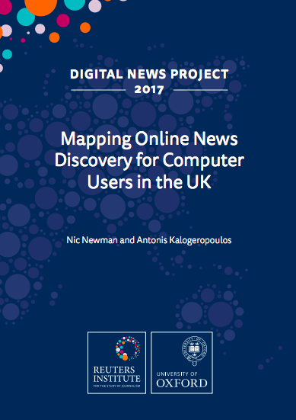
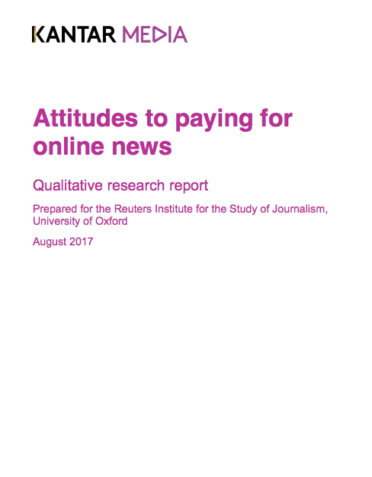
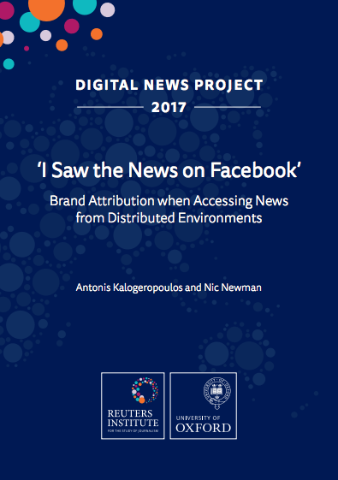
More information
digitalnewsreport.org/publications

Slide 18
OVERVIEW OF THE DIGITAL NEWS ECOSYSTEM
Polly Curtis – Editor-in-Chief, HuffPost
Alison Gow – Editor-in-Chief, Digital, Trinity Mirror
Douglas McCabe – CEO and Director of publishing and Tech, Enders Analysis
Nic Newman – Senior Research Associate, Oxford University
@PressGazette @NewsUK @Newsdit2 #Journosummit17

Slide 19
Digital Journalism Summit
Newspapers and digital outlook
Douglas McCabe | douglas.mccabe@endersanalysis.com | 020 7851 0910
20th October 2017

Slide 20
National newspaper circulation trends
2014-2016
-9%
-15%
-10%

Slide 21
Decline of daily print news: smartphones the killer blow

Slide 22
Digital scale – reach, time spent

Slide 23
Time spent with tablet [and print] services

Slide 24
Two thirds of newsbrand digital audiences come from Google and Facebook

Slide 25
More than 50% of all advertising spend is digital

Slide 26
Press to online advertising substitution

Slide 27
Newspapers are minnows in digital advertising: 5% share and falling

Slide 28
It’s direct response – or activation – advertising that’s growing
[Source: Enders Analysis estimates based on Warc/AA]

Slide 29
We have gone from 40:60 activation/brand to 50:50

Slide 30
90% of digital ad growth is Google and Facebook, with news losing share

Slide 31
SME expenditure with local media and global platforms

Slide 32
The UK press is the least trusted in Europe; TV is in the bottom third

Slide 33
Discussion points
1 | Digital marketing landscape: unregulated, but structurally biased against quality content
2 | Fake news, news branding, search & social algorithms
3 | What are the right metrics for news media…? Reach? Editorial purpose?
4 | Terms of engagement, discussion framework: product, business, tech, data
[Source: Enders Analysis]

Slide 34
OVERVIEW OF THE DIGITAL NEWS ECOSYSTEM
Polly Curtis – Editor-in-Chief, HuffPost
Alison Gow – Editor-in-Chief, Digital, Trinity Mirror
Douglas McCabe – CEO and Director of publishing and Tech, Enders Analysis
Nic Newman – Senior Research Associate, Oxford University
@PressGazette @NewsUK @Newsdit2 #Journosummit17

Slide 35
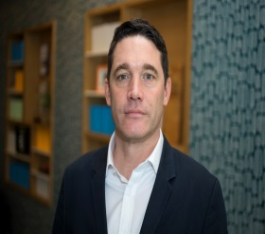
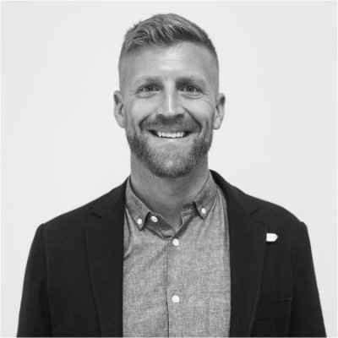
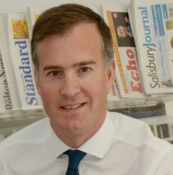
ONLINE ADVERSTISING. IS THE SYSTEM BROKEN AND HOW CAN WE FIX IT?
Alistair MacCallum – Chief Executive Officer, m/SIX
Daniel Spears – Programmatic Director, The Guardian
Henry Faure Walker – Chief Executive Officer, Newsquest Media Group
@PressGazette @NewsUK @Newsdit2 #Journosummit17

Slide 36






Digital adspend
60%
Duopoly
Buyers
Secondary intermediary
“resellers”
<15%
>45%
Fraud &
NHT
Primary intermediary
“ad exchanges”
3x
Premium publishers
Longtail
Consumer engagement
Source: Integral Ad Science; publisher data & 2017 H1 global benchmarks + Lumen Research

Slide 37
ONLINE ADVERSTISING. IS THE SYSTEM BROKEN AND HOW CAN WE FIX IT?
Alistair MacCallum – Chief Executive Officer, m/SIX
Daniel Spears – Programmatic Director, The Guardian
Henry Faure Walker – Chief Executive Officer, Newsquest Media Group
@PressGazette @NewsUK @Newsdit2 #Journosummit17

Slide 38



Slide 39


Slide 40
Newsquest local news brands digital reach
% OF IN MARKET ADULTS VISITING THEIR LOCAL NEWSQUEST WEBSITE PER MONTH
SOURCE: TELMAR / JICREG

Slide 41
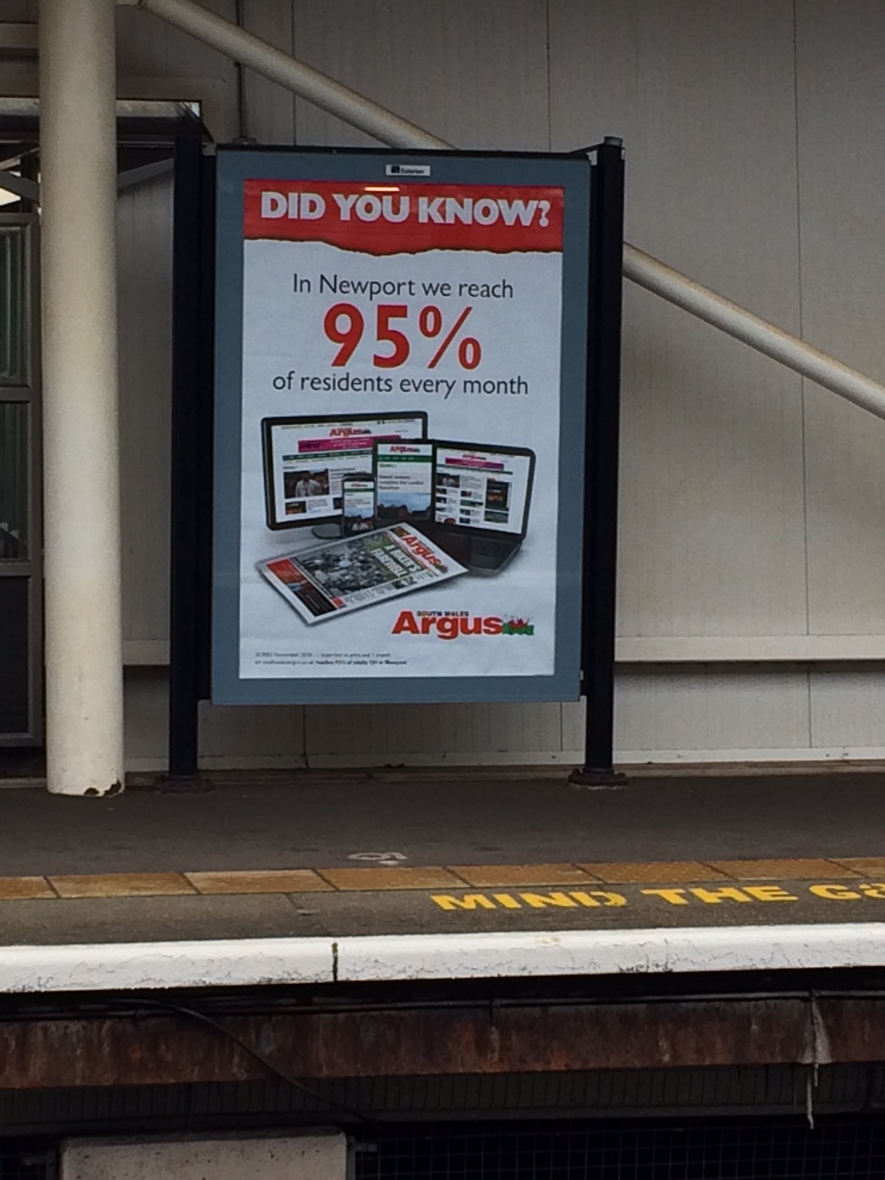

Slide 42
Local news brands beat Facebook hands down when it comes to trust and relevance
SOURCE: COMSCORE SURVEY OF 3,300 UK DIGITAL USERS

Slide 43







































1XL = The combined power of local news brands’ audience across the UK
A unique digital publisher co-operative of 30 of the UK’s premium regional news publishers
800 trusted local new brands providing quality, responsive and brand safe environments for marketing campaigns
A monthly unique user reach of 23.4m (Comscore) and an average in-area reach that exceeds 80% in certain regions (e.g. Scotland)
Highly targeted delivery through extensive first party data collection
Available to national advertisers and agencies in one buy
=

Slide 44
ONLINE ADVERSTISING. IS THE SYSTEM BROKEN AND HOW CAN WE FIX IT?
Alistair MacCallum – Chief Executive Officer, m/SIX
Daniel Spears – Programmatic Director, The Guardian
Henry Faure Walker – Chief Executive Officer, Newsquest Media Group
@PressGazette @NewsUK @Newsdit2 #Journosummit17

Slide 45
Digital Journalism Summit 2017
In association with
@PressGazette @NewsUK @Newsdit2 #Journosummit17

Slide 46
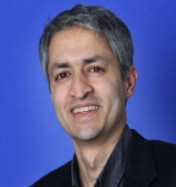
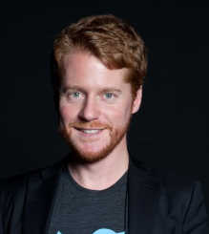
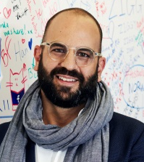
THE DIGITAL GIANTS, PART OF THE PROBLEM OR THE SOLUTION?
Madhav Chinnappa - Director of Strategic Relations for News & Publishers, Google
Jerome Tomasini - News & Sports Content Partnerships Manager, Twitter France
Patrick Walker - Director of Media Partnerships, EMEA, Facebook
@PressGazette @NewsUK @Newsdit2 #Journosummit17

Slide 47
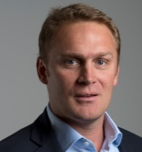
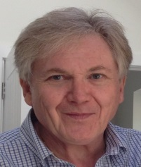
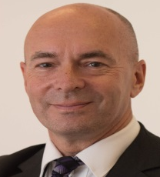
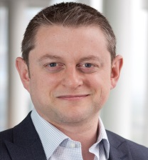
NEW WAYS TO MAKE JOURNALISM PAY ITS WAY IN THE DIGIAL AGE
Robert Bridge – Chief Customer Officer, The Telegraph
Karl Capp – Founder, Newsdit
Pete Clifton – Editor-in-Chief, PA
Chris Duncan – Managing Director, TNL
@PressGazette @NewsUK @Newsdit2 #Journosummit17

Slide 48
NEW WAYS TO MAKE JOURNALISM PAY ITS WAY IN THE DIGIAL AGE
Robert Bridge – Chief Customer Officer, The Telegraph
Karl Capp – Founder, Newsdit
Pete Clifton – Editor-in-Chief, PA
Chris Duncan – Managing Director, TNL
@PressGazette @NewsUK @Newsdit2 #Journosummit17

Slide 49
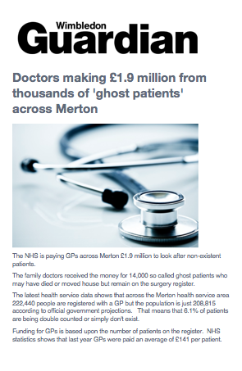
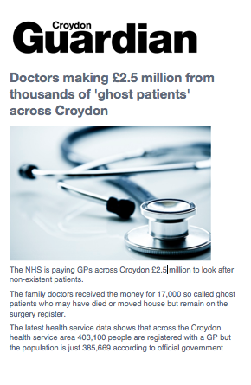
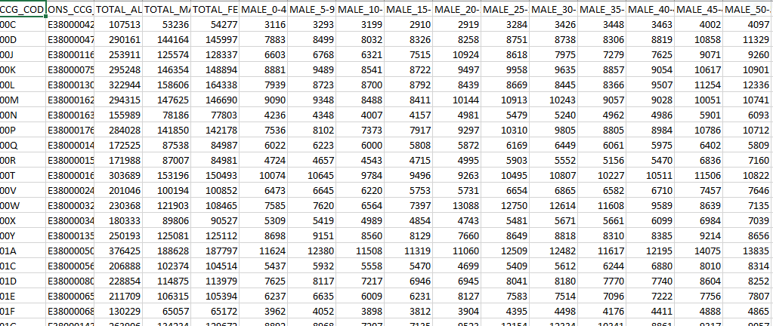
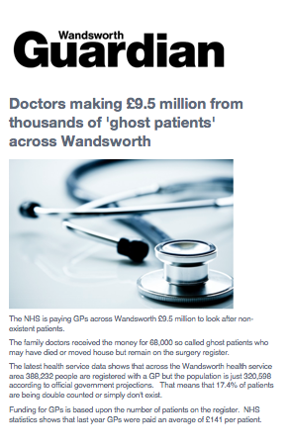
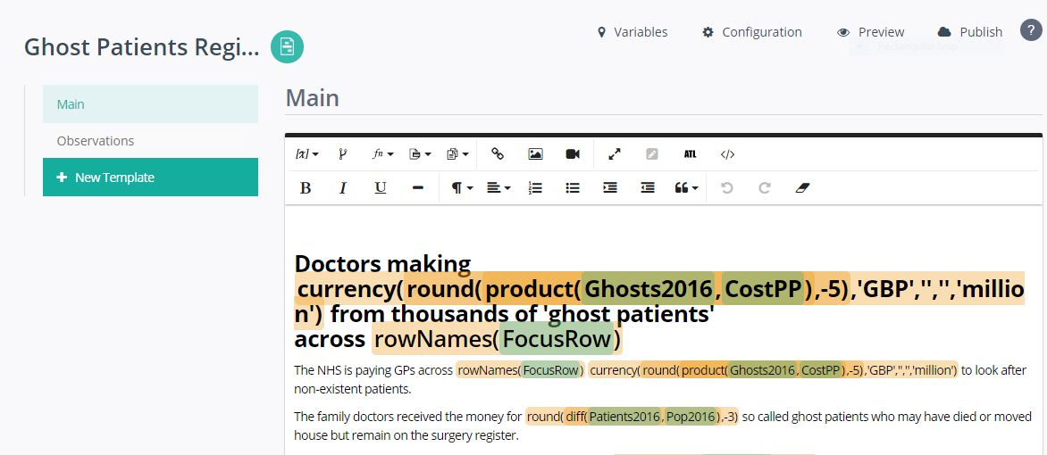
Project RADAR
NHS and population data

Slide 50
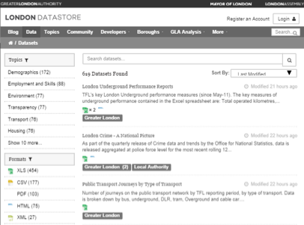
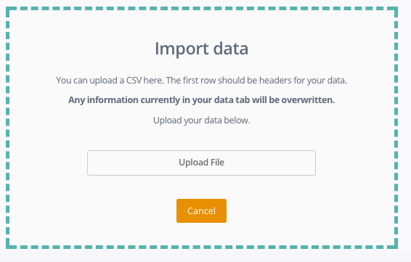
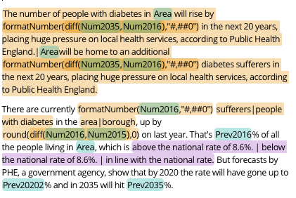
Through an editorial driven use of Natural Language Generation, we can localise for every market
Identify newsworthy localised datasets
Mine data for story lines
Structure data to enable automation
Load data into Natural Language Generation tool
Write story templates to cover all eventualities of story
Template branching to cover different angles/emphasis
Feed data through template to produce multiple local stories

Slide 51
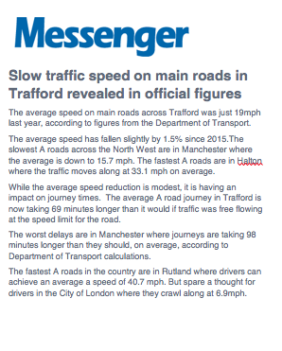
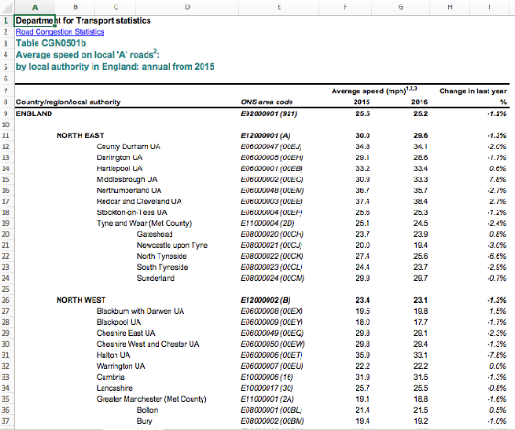
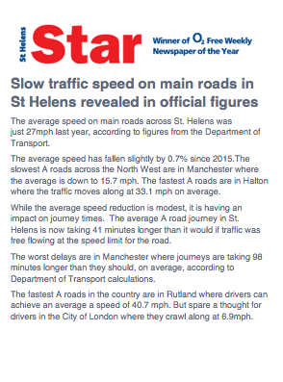
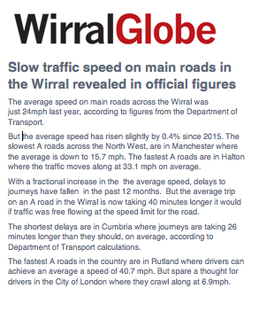
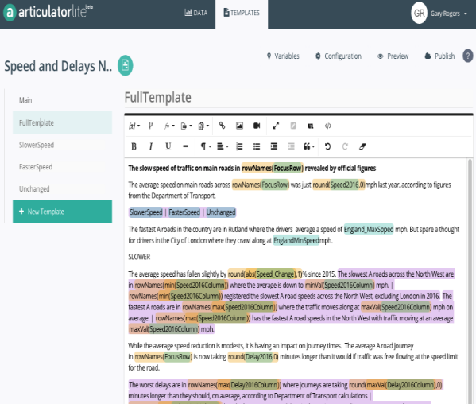
Story Example – Transport Data
Dept of Transport data (Local Authority)
Template process for automation

Slide 52
Project RADAR: What’s next?
Recruiting of journalists and data analyst happening now
Trials start before the end of the year
Production scaled up over over six months
Content offered as free trial to customers
Live market testing of pricing models
Infographics/video introduced into service

Slide 53
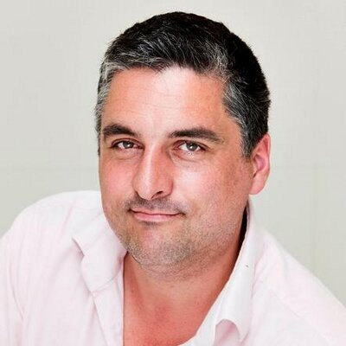
CLOSING COMMENTS - DOMINIC PONSFORD
EDITOR, PRESS GAZETTE
@PressGazette @NewsUK @Newsdit2 #Journosummit17

Slide 54
Digital Journalism Summit 2017
In association with
@PressGazette @NewsUK @Newsdit2 #Journosummit17

